Slide 1
Annotating Text
Learning Intention: To be able to identify important parts of a text
Success Criteria: I can identify and label persuasive writing techniques in a text

Slide 2
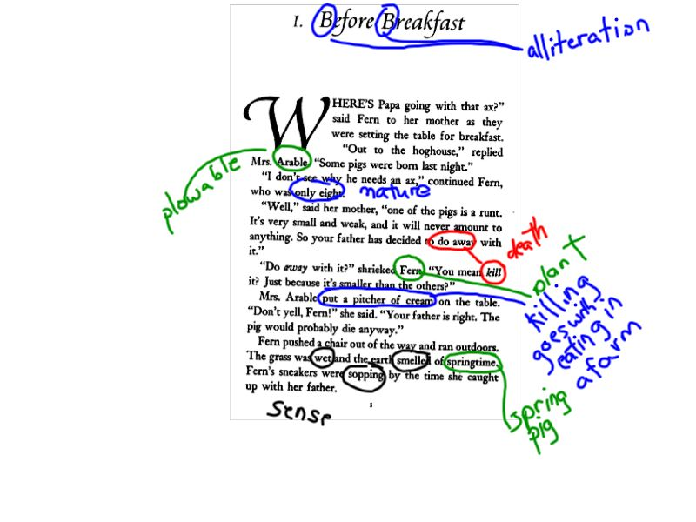
Annotating - to add explanations or notes to your text

Slide 3
Should animals be kept in cages in a zoo
To keep animals in zoos can have useful purposes for research and can protect animals who may not survive in the wild. However to keep animals in cages is a cruelty and an injustice to animals.

Slide 4
Should animals be kept in cages in a zoo
To keep animals in zoos can have useful purposes for research and can protect animals who may not survive in the wild. However to keep animals in cages is a cruelty and an injustice to animals.
Strong words

Slide 5
Zoos have some advantages when it comes to keeping animals in captivity. For endangered animals zoos can provide protection for those who would not survive in the wild, and have breeding programs that ensure the survival of these animals. If animals are kept in well-established facilities and the zoos are well funded to meet the health and medical needs of the animals, then there is no reason why these animals should not be well looked after. However most zoos around the world are not well funded and have terrible small, cramped areas. If elephants are kept in small facilities this causes damage to their feet that can often not be repaired and is cruel to the animals.

Slide 6
Zoos have some advantages when it comes to keeping animals in captivity. For endangered animals zoos can provide protection for those who would not survive in the wild, and have breeding programs that ensure the survival of these animals. If animals are kept in well-established facilities and the zoos are well funded to meet the health and medical needs of the animals, then there is no reason why these animals should not be well looked after. However most zoos around the world are not well funded and have terrible small, cramped areas. If elephants are kept in small facilities this causes damage to their feet that can often not be repaired and is cruel to the animals.
First argument

