Slide 1
Persuasive language
Modality
Rhetorical Questions
Statistics
Strong Words
Inclusive Language

Slide 2
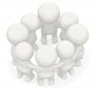
How are we persuaded?
There are many techniques or tricks that a writer or a speaker can use to win an audience to their point of view.
%
?
O
T
R
E
I
H
C
R
A
L
Strong
Words
S t a t i s t i c s
Q
U
E
S
T
I
O
N
S
Inclusive
Modality
Language

Slide 3
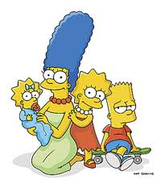
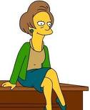
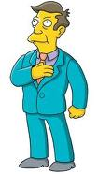
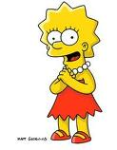
Rhetorical Questions
A Rhetorical Question is one that is asked with a deliberate and obvious answer to follow.
The writer doesn't even expect the readers to 'say' an answer; the readers answer the rhetorical question in their heads
That is, it virtually demands the answer from the reader or listener.
Don’t we all love our Mum?
Isn’t education terrific?

Slide 4
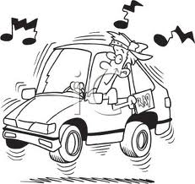
Strong Words
Nouns
Adjectives
Particular words are used to name or describe people or things in a way that is designed to make the reader think a particular way.
Dangerous hoons are a menace (strong words).
As different from …
Young drivers who speed (more factual and less descriptive).

Slide 5
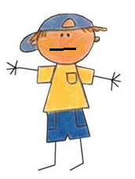
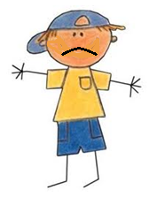
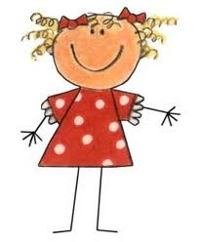
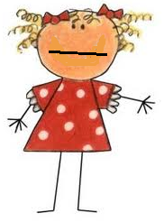
Statistics
The use of statistics to provide support for an argument can be impressive.
But statistics can be manipulated to make a situation sound different to reality.
In a recent poll 45 % of the voters want Corey to be School Captain, 30% want Kristy and 25 % are undecided.
Therefore, 55% of the voters can’t commit themselves to Corey.
That’s more than half, so he can’t be doing well.

Slide 6
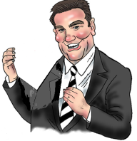
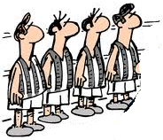
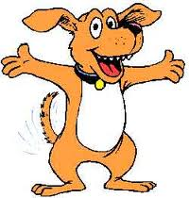
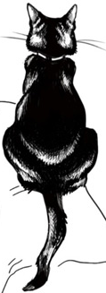
Inclusive Language
Inclusive language is used when the writer or speaker makes a statement that claims to agree with the audience and can even flatter them so they will agree with the speaker.
Intelligent people like you and I will recognise that Football is better than Soccer.
We all know cats make better pets than dogs.

Slide 7
Modality
Modality is how strongly something is being said.
The strength of the statement is created through the words that are used.
must
Every student
should
wear school uniform.
could
always
Australians will
often
give to worthy causes
sometimes

